Slide 1
Indexing and Hashing
Database systems

Slide 2
Indexing
Indexing is a data structure technique to efficiently retrieve records from database files based on some attributes on which the indexing has been done.
Indexing in database systems is similar to the one we see in books.
Two basic kinds of indices:
Ordered indices: search keys are stored in sorted order
Hash indices: used to access data that is distributed uniformly across a range of buckets using a “hash function”.

Slide 3
Purpose of Indexing
It is a data structure that is added to a file to provide faster access to the data.
It reduces the number of blocks that the DBMS has to check.

Slide 4
Index Evaluation Metrics
Access types: Access types supported efficiently. E.g.,
records with a specified value in the attribute
or records with an attribute value falling in a specified range of values.
Access time: Time it takes to find a particular data item, or set of items, using the technique
Insertion time: Time it takes to insert a new data item. This value includes the time it takes to find the correct place to insert the new data item, as well as the time it takes to update the index structure
Deletion time: Time it takes to delete a data item. This value includes the time it takes to find the item to be deleted, as well as the time it takes to update the index structure
Space overhead: The additional space occupied by an index structure.

Slide 5
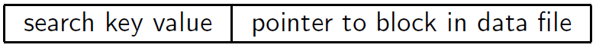
Basic Concepts
Search Key: An attribute or set of attributes used to look up records in a file is called search key.
An Index file consists of records( called index entries) of the form

Slide 6
Ordered Indices
Each index structure is associated with a particular search key.
An ordered index, stores the value of the search keys in sorted order and associates with each search key the record that contains it. E.g., index of a book, library catalog.
A file may have several indices, on different search keys.

Slide 7
Ordered Indices
Primary index: in a sequentially ordered file, the index whose search key specifies the sequential order of the file.
Also called clustering index
The search key of a primary index is usually but not necessarily the primary key.
Secondary index: an index whose search key specifies an order different from the sequential order of the file.
Also called non-clustering index.
Index-sequential file: ordered sequential file with a primary index.

Slide 8
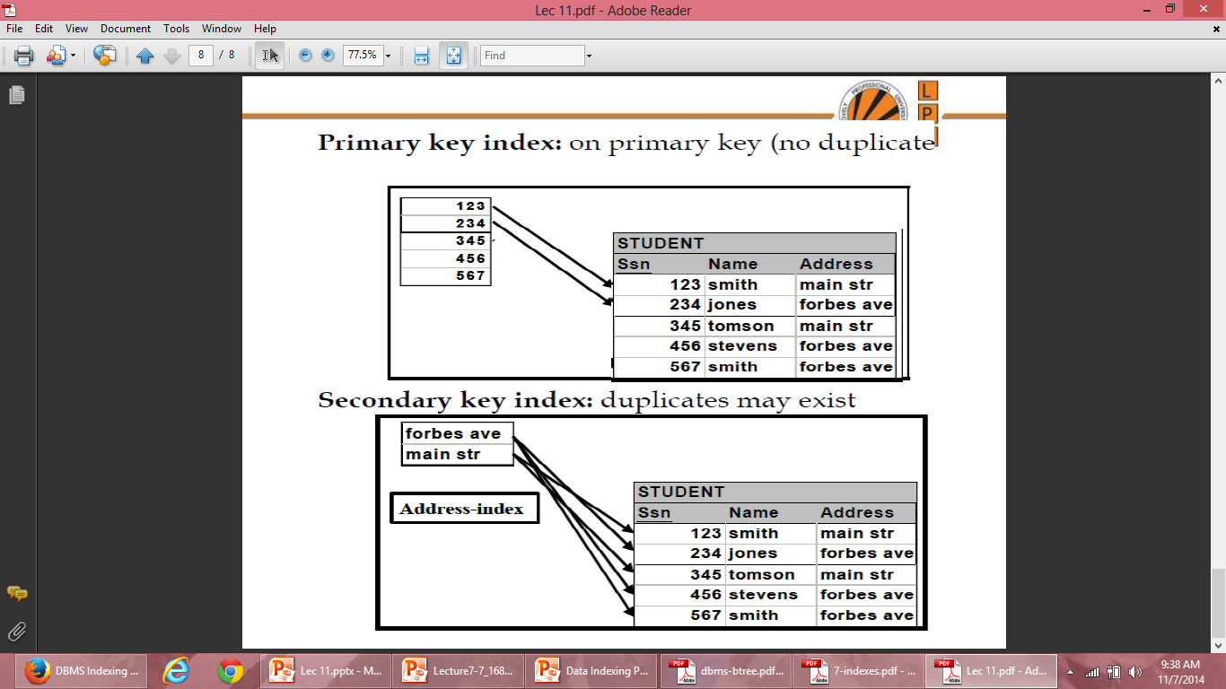

Slide 9
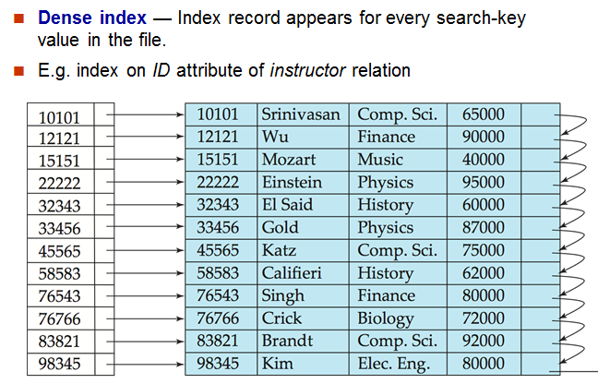
Dense Index Files

Slide 10
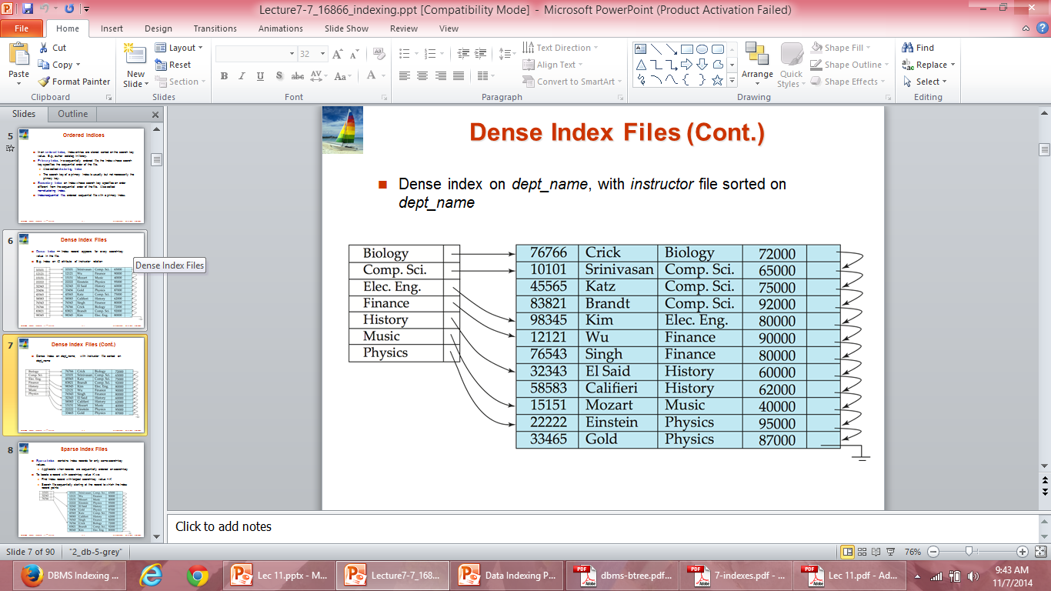
Dense Index Files

Slide 11
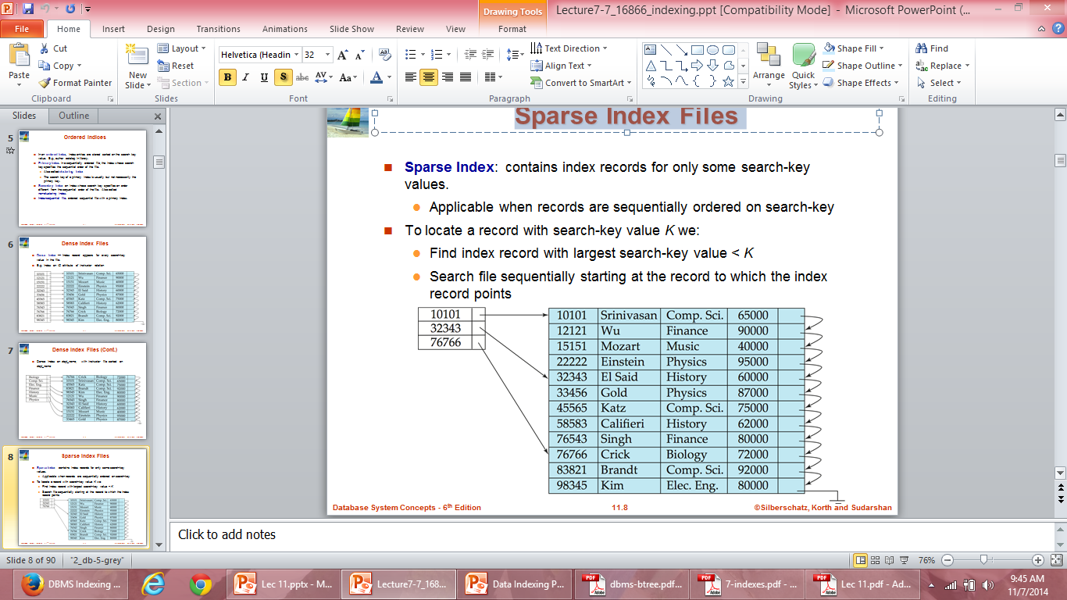
Sparse Index Files

Slide 12
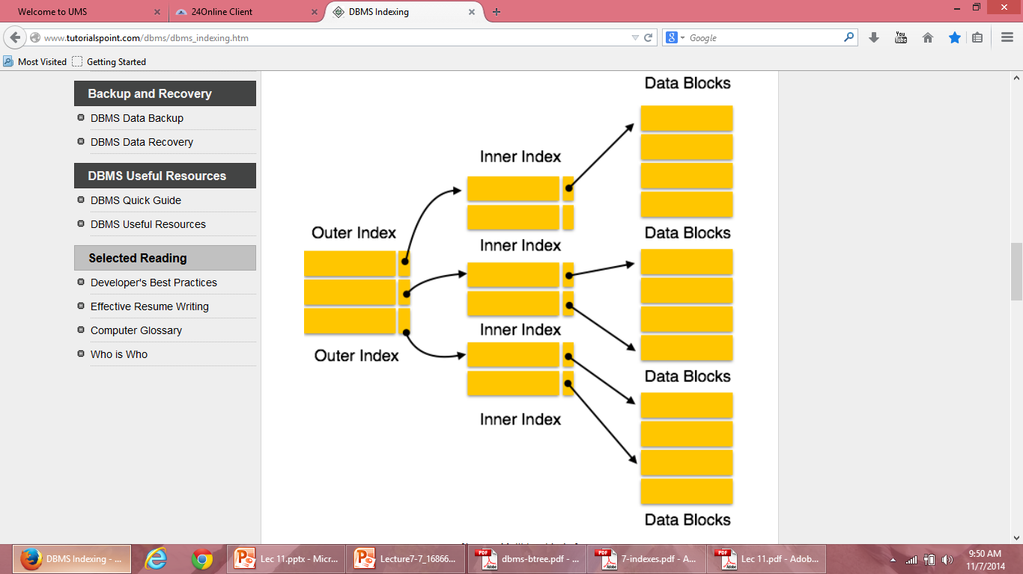
Multilevel Index

Slide 13
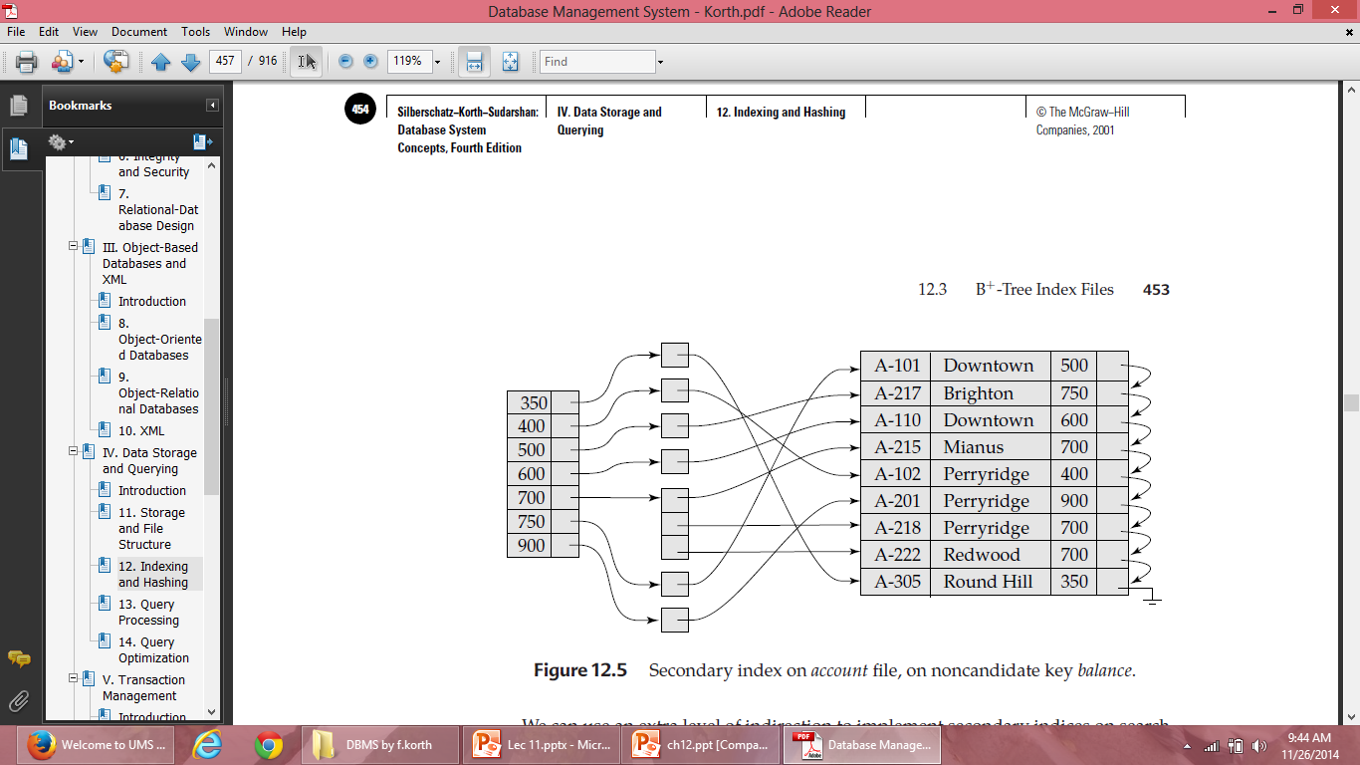
Secodary idices EXAMPLE

Slide 14
Hashing
One disadvantage of sequential file organization is that we must access an index structure to locate data, or must use binary search, and that results in more I/O operations.
File organizations based on the technique of hashing allow us to avoid accessing an index structure.
Hashing also provides a way of constructing indices.

Slide 15
Example
Hash file organization of account file, using branch_name as key
There are 10 buckets,
The binary representation of the ith character is assumed to be the integer i.
The hash function returns the sum of the binary representations of the characters modulo 10
E.g. h(Perryridge) = 5 h(Round Hill) = 3 h(Brighton) = 3

Slide 16
Hashing
A bucket is a unit of storage containing one or more records (a bucket is typically a disk block).
In a hash file organization we obtain the bucket of a record directly from its search-key value using a hash function.
Hash function h is a function from the set of all search-key values K to the set of all bucket addresses B.

Slide 17
Static Hashing
In static hashing, when a search-key value is provided the hash function always computes the same address.
For example, if mod-4 hash function is used then it shall generate only 5 values. The output address shall always be same for that function. The numbers of buckets provided remain same at all times.

Slide 18
Handling of Bucket Overflows
If the bucket does not have enough space, a bucket overflow is said to occur.
Bucket overflow can occur for several reasons:
Insufficient buckets: The number of buckets, denoted by nB , must be chosen such that nB > nr /fr, where nr denotes the total number of records that will be stored and fr denotes the number of records that will fit in a bucket.
Skew: Some buckets are assigned more records than are others, so a bucket may overflow even when other buckets still have space. This situation is called bucket skew. This can occur due to two reasons:
multiple records have same search-key value
chosen hash function produces non-uniform distribution of key values

Slide 19
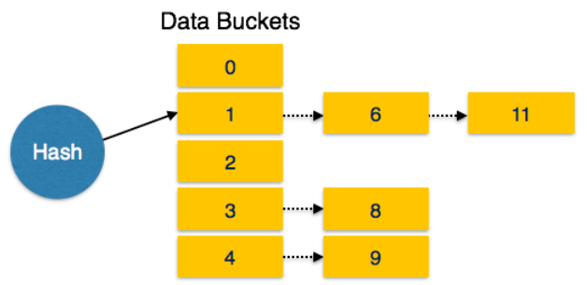
Handling of Bucket Overflows
Although the probability of bucket overflow can be reduced, it cannot be eliminated; it is handled by using overflow buckets.
Overflow chaining – the overflow buckets of a given bucket are chained together in a linked list.
Above scheme is called closed hashing.

Slide 20
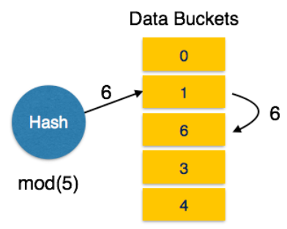
Handling of Bucket Overflows
Linear Probing: When hash function generates an address at which data is already stored, the next free bucket is allocated to it. This mechanism is called Open Hashing.
Open hashing does not use overflow buckets, is not suitable for database applications.

Slide 21
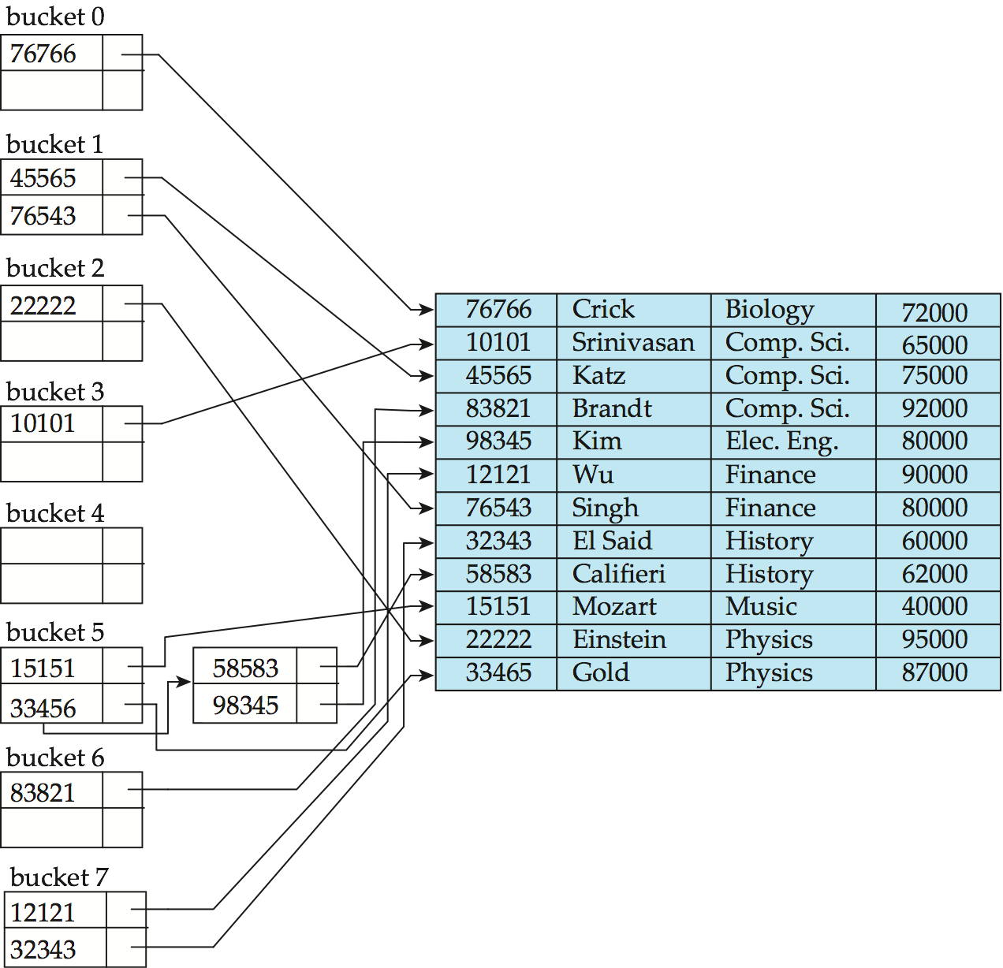
Example of Hash Index

Slide 22
Hashing Practice Problems Problem 1
Consider a hash table of size seven, with starting index zero, and a hash function (3x + 4)mod7. Assuming the hash table is initially empty, which of the following is the contents of the table when the sequence 1, 3, 8, 10 is inserted into the table using Open hashing? Note that ‘_’ denotes an empty location in the table.
(A) 8, _, _, _, _, _, 10 (B) 1, 8, 10, _, _, _, 3 (C) 1, _, _, _, _, _,3 (D) 1, 10, 8, _, _, _, 3

Slide 23
1=> (3x+4)mod7=7mod7=0
3 => (3x+4)mod7=13mod7=6
8 => (3x+4)mod7=28mod7=0
Because address ‘0’ is not empty, store 8 at next empty data bucket ‘1’
10 => (3x+4)mod7=34mod7=6
Because address ‘6’ is not empty, store 10 at next empty data bucket ‘2’
Correct option is B

Slide 24
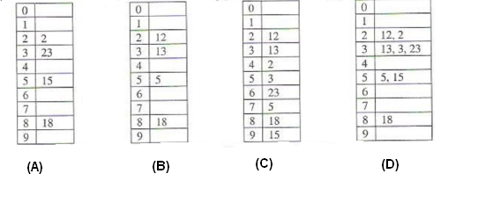
Problem 2
The keys 12, 18, 13, 2, 3, 23, 5 and 15 are inserted into an initially empty hash table of length 10 using open addressing with hash function h(k) = k mod 10 and linear probing. What is the resultant hash table?

Slide 25
H(k)=kmod10
12=> 12mod10=2
18=>18mod10=8
13=>13mod10=3
2=>2mod10=2, not empty, next available=4
3=>3mod10=3, not empty, next available=5
23=>23mod10=3, not empty, next available=6
5=>5mod10=5, not empty, next available=7
15=>15mod10=5, not empty, next available=9
Correct option is C

Slide 26
Problem 3
For question number 2, what would the correct option if method used is closed hashing?
H(k)=kmod10
12=> 12mod10=2
18=>18mod10=8
13=>13mod10=3
2=>2mod10=2
3=>3mod10=3
23=>23mod10=3
5=>5mod10=5
15=>15mod10=5
Correct option is D

Slide 27
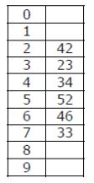
Problem 4
A hash table of length 10 uses open addressing with hash function h(k)=k mod 10, and linear probing. After inserting 6 values into an empty hash table, the table is as shown below.

Slide 28
Which one of the following choices gives a possible order in which the key values could have been inserted in the table? (A) 46, 42, 34, 52, 23, 33 (B) 34, 42, 23, 52, 33, 46 (C) 46, 34, 42, 23, 52, 33 (D) 42, 46, 33, 23, 34, 52

Slide 29
Solution: We will check whether sequence given in option A can lead to hash table given in question. Option A inserts 46, 42, 34, 52, 23, 33 as:
For key 46, h(46) is 46%10 = 6. Therefore, 46 is placed at 6th index For key 42, h(42) is 42%10 = 2. Therefore, 42 is placed at 2nd index For key 34, h(34) is 34%10 = 4. Therefore, 34 is placed at 4th index
For key 52, h(52) is 52%10 = 2. However, index 2 is occupied with 42. Therefore, 52 is placed at 3rd index in the hash table. But in given hash table, 52 is placed at 5th index. Therefore, sequence in option A can’t generate hash table given in question.
In the similar way, we can check for other options as well which leads to answer as (C).

Slide 30
The keys 12, 18, 13, 2, 3, 23, 5 and 15 are inserted into an initially empty hash table of length 10 using open addressing with hash function h(k) = k mod 10 and linear probing. What is the resultant hash table?

